Slide 1

Codecs
A codec is a device or program capable of performing encoding and decoding on a digital data stream or signal.
The word codec may be a combination of any of the following: 'compressor-decompressor', 'coder-decoder', or 'compression/decompression algorithm'.

Slide 2
Codecs (Usage)‏
Codecs encode a stream or signal for transmission, storage or encryption and decode it for viewing or editing. Codecs are often used in videoconferencing and streaming media applications.
An audio compressor converts analogue audio signals into digital signals for transmission or storage. A receiving device then converts the digital signals back to analogue using an audio decompressor, for playback.

Slide 3
Container Formats
Many multimedia data streams need to contain both audio and video data, and often some form of metadata that permits synchronisation of audio and video. Each of these three streams may be handled by different programs, processes, or hardware; but for the multimedia data stream to be useful in stored or transmitted form, they must be encapsulated together in a container format.

Slide 4
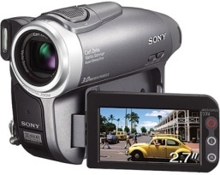
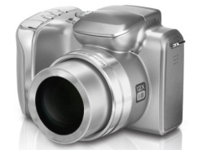
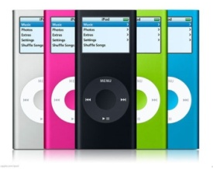
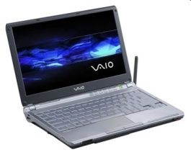
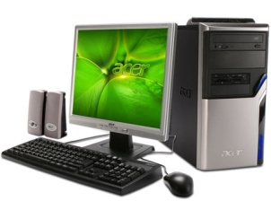

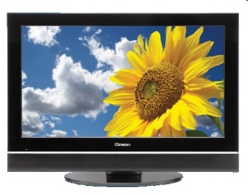
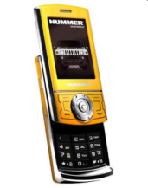
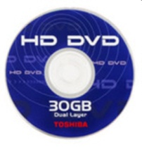
Image, Video, Audio
Image | Video | Audio
JPEG, JPEG-LS, LOCO, CALIC | MPEG 1,2,4,7, 21 | Dolby True HD
JPEG 2000 | H.264, H.265 - HEVC | HD-AAC
JPEG XR–AIC | VP6, VP7, VP8, VP9 | MP3, MP3 Pro
JBIG1,2 | VC–1 (WMV–9) | AAC–SBR
PNG | Wyner Ziv | HE–AC3
GIF | AVS China part 2 | AVS China part 3
 | Dirac,Dirac Pro(BBC) | ATSC (E-AC3)
 | Real Networks-RV10 | WMA
 |  | DTS-HD Audio
Notes:
<numero>
<numero>
Most of these software codecs are proprietary material. But Dr Rao’s influential networking has enabled him to get most of these codecs strictly for academic research in his lab. So one will have hands on experience in the latest technology by the time one leaves the university. For example work is being done h.265 in the industry but it is yet to be released as a standard; Dr Rao has his former students working on this and they collaborate with MPL to do some research on this.

Slide 5
Container Formats
Ogg
QuickTime
RealMedia
Matroska
MP4
DivX

Slide 6
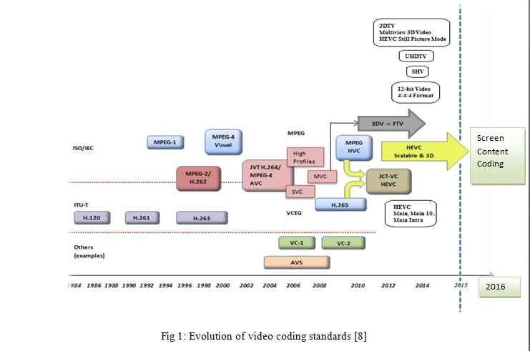
EVOLUTION OF VIDEO CODING STANDARDS [8]:

Slide 7
Popular Audio Codecs
The most popular audio codecs are all lossy.
Dolby Digital (AC3)‏
MP3 (MPEG-1 Audio Layer 3)‏
Advanced Audio Coding (AAC)‏
Vorbis
Free Lossless Audio Codec (FLAC)

Slide 8
Popular Video Codecs
The most popular video codecs are all lossy.
MPEG-4 ASP (includes Xvid, FFmpeg and DivX)‏
H264
vp8
RealVideo
New: H265 (HEVC), vp9

Slide 9
Dolby Digital (AC3)‏
Dolby Digital, or AC-3, is the common version containing up to six discrete channels of sound, with five channels for normal-range speakers (20 Hz – 20,000 Hz) (right front, center, left front, right rear and left rear) and one channel (20 Hz – 120 Hz) for the subwoofer driven low-frequency effects. Mono and stereo modes are also supported. AC-3 supports audio sample-rates up to 48KHz.
Batman Returns was the first film to use Dolby Digital technology when it premiered in theaters in Summer 1992.

Slide 10

MP3
MP3 uses a lossy compression algorithm that is designed to greatly reduce the amount of data required to represent audio recordings, yet still sound like faithful reproductions of the original uncompressed audio to most listeners. An MP3 digital file created using the mid-range bitrate setting of 128 kbit/s results in a file that is typically about 1/10th the size of the CD file created from the same audio source.
LAME is a popular open source MP3 encoder.

Slide 11
MP3
It provides a representation of sound within a short term time/frequency analysis window, by using psychoacoustic models to discard or reduce precision of components less audible to human hearing, and recording the remaining information in an efficient manner. These techniques are called "Perceptual Coding".
Other techniques such as Huffman Coding (lossless), variable speed encoding and joint stereo encoding are part of the mp3 codec.

Slide 12
Variable BitRate (VBR) Encoding
Variable BitRate encoding is designed for size & quality optimalization. Where there is silence in the music, it is less "demanding" in terms of its encodability, it makes sense to drop the bit rate, simply because there's not much there to encode, and the wasted space is overkill. Where the full orchestra and high noise percussion is joining in, the encoder will choose a higher bitrate appropriate to the demands. Some parts of the music can be encoded in 128 kbps (kilo bits per second) without any quality loss, other parts get the full 320 kbps to make the best of it.

Slide 13
Joint Stereo Encoding
Joint stereo is a method to save some bandwidth by encoding certain parts of the spectrum in mono (i.e. only once) for which the human ear has no directional hearing. These are very low and very high tones.
The bandwidth is saved by recording a wider sum channel and a narrower difference channel, where the difference channel does not contain these spectral components.
This works very well and produces excellent quality at 128 Kbit/s for most pieces of music (but not all!).

Slide 14
Advanced Audio Coding (AAC)‏
Advanced Audio Coding (AAC) is a standardized, lossy compression and encoding scheme for digital audio. Designed to be the successor of the MP3 format, AAC generally achieves better sound quality than MP3 at the same bitrate, particularly below 192 kbit/s.
AAC's best known use is as the default audio format of Apple's iPhone, iPod, iTunes, and the format used for all iTunes Store audio (with extensions for proprietary digital rights management).

Slide 15
Advanced Audio Coding (AAC)‏
AAC is a wideband audio coding algorithm that exploits two primary coding strategies to dramatically reduce the amount of data needed to represent high-quality digital audio.
1. Signal components that are perceptually irrelevant are discarded;
2. Redundancies in the coded audio signal are eliminated.
3. The signal is processed by a modified discrete cosine transform (MDCT) according to its complexity. Avoids overlapping artifacts.

Slide 16
Vorbis Audio Codec
Vorbis is a free and open source, lossy audio codec project headed by the Xiph.Org Foundation and intended to serve as a replacement for MP3. It is most commonly used in conjunction with the Ogg container and is therefore called Ogg Vorbis.
For many applications, Vorbis has clear advantages over other lossy audio codecs in that it is patent-free and has free and open-source implementations and therefore is free to use, implement, or modify as one sees fit, yet produces smaller files than most other codecs at equivalent or higher quality

Slide 17
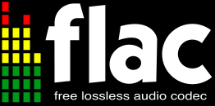
Free Lossless Audio Codec
FLAC is an audio format using lossless compression. It is the most popular lossless audio codec.
FLAC achieves compression rates of 30–50% for most music, with significantly greater compression for voice recordings.
FLAC uses linear prediction to convert the audio samples to a series of small, uncorrelated numbers (known as the residual), which are stored efficiently using Golomb-Rice coding (quotient/remainder pairs using a divisor that is a power of two: 2,4,8...). Entropy coding is used for silent parts.

Slide 18
Fundamental Concepts in Video Coding [10]:
Color Spaces
RGB color space – Each pixel is represented by three numbers indicating the relative proportions of red, green and blue colors.
YC_{r}C_{b} color space – Y is the luminance component and C_{r ,}C_{b} - two color difference or chrominance components.
As the human visual system is less sensitive to color than the luminance component, YC_{r}C_{b} has advantages over RGB space.

Slide 19
MPEG-4 Video Codec
MPEG-4 is a collection of methods defining compression of audio and visual (AV) digital data. It was introduced in late 1998 and designated a standard for a group of audio and video coding formats and related technology.
MPEG-4 absorbs many of the features of MPEG-1 and MPEG-2 and other related standards, adding new features such as (extended) VRML support for 3D rendering, object-oriented composite files (including audio, video and VRML objects), support for externally-specified Digital Rights Management and various types of interactivity.

Slide 20
Parts of MPEG-4 Video Codec
MPEG-4 Part 2 is a video compression technology developed by MPEG. It is a discrete cosine transform compression standard, similar to previous standards such as MPEG-1 and MPEG-2. Several popular codecs including DivX, Xvid and Nero Digital are implementations of this standard.
H.264 is a standard for video compression, and is equivalent to MPEG-4 Part 10, or MPEG-4 AVC (for Advanced Video Coding). x264 is a free software library for encoding H.264/MPEG-4 AVC video streams.

Slide 21
Lumi Masking
Lumi masking is a technique used by video compression software, which reduces quality in very bright or very dark areas of the picture, as quality loss in these areas is less likely to be visible. It is also known as "psychovisual enhancements" or "adaptive quantization". The reduction in quality (and therefore bitrate) in certain areas of the picture caused by using lumi masking allows more bits to be allocated to the rest of the video, thus improving overall quality. Lumi masking is not perfect, however, and in some cases the degradation in quality it causes is visible.

Slide 22
Trellis Quantization
Trellis quantization is an algorithm that can improve data compression in DCT-based encoding methods. It is used to optimize residual DCT coefficients after motion estimation in lossy video compression encoders such as Xvid.
Trellis quantization reduces the size of some DCT coefficients while recovering others to take their place. Trellis quantization effectively finds the optimal quantization for each block to maximize the peak s/n ratio relative to bitrate. It has varying effectiveness depending on the input data and compression method.

Slide 23
Container formats : DIVX
In June 2005, DivX, Inc. released its own container format called DivX Media Format (.divx extension) to succeed the AVI + DivX combo. However, this format is basically an enhanced AVI format (based on the same RIFF structure, for backward compatibility with existing players and devices) and so far, has gained no perceivable consumer traction, even where the DivX codec was once popular (the Xvid codec has instead become the codec of choice among most of the file-sharing groups).

Slide 24
Container formats : Matroska
The Matroska Multimedia Container is an open standard free container format, a file format that can hold an unlimited number of video, audio, picture or subtitle tracks inside a single file. It is intended to serve as a universal format for storing common multimedia content, like movies or TV shows.
Matroska file types are .MKV for video (with subtitles and audio), .MKA for audio-only files and .MKS for subtitles only. The most common use of .MKV files are used to store HD video files.

Slide 25
Container formats : MP4
MPEG-4 Part 14, is a multimedia container format standard specified as a part of MPEG-4. It is most commonly used to store digital audio and digital video streams, especially those defined by MPEG, but can also be used to store other data such as subtitles and still images. Like most modern container formats, MPEG-4 Part 14 allows streaming over the Internet. The official filename extension for MPEG-4 Part 14 files is .mp4, thus the container format is often referred to simply as MP4.

Slide 26
Container formats : FLV
FLV files contain video bit streams which are a variant of the H.263 video standard, under the name of Sorenson Spark. Flash Player 8 and newer revisions support the playback of On2 TrueMotion VP6 video bit streams. On2 VP6 can provide a higher visual quality than Sorenson Spark, especially when using lower bit rates. On the other hand it is computationally more complex and therefore will not run as well on certain older system configurations. Flash Player 9 Update 3 includes support for H.264 video standard (MPEG-4 part 10, or AVC) which is even more computationally demanding, but offers significantly better quality/bitrate ratio.

